Slide 1
How screen reader software deals with charts

Slide 2
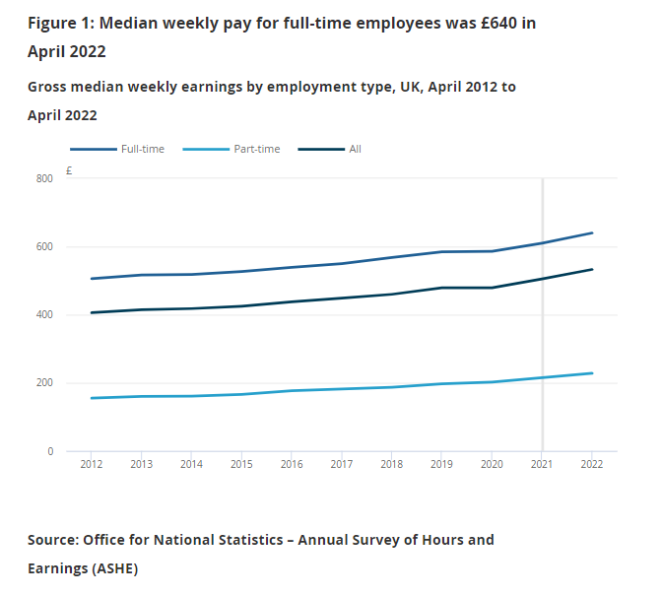
Example
This slide shows a screenshot of a chart from Employee earnings in the UK: 2022.
This is a publication from the Office for National Statistics (ONS).
It shows how a chart is displayed in an ONS publication.
It shows the headline title, the statistical title, a line chart and source information.

Slide 3
Recording
This slide has an audio file. Double click the recording icon to open the file.
This file is a recording of what the NVDA screen reader software would read out if it came across the chart on the previous slide.

Slide 4
Transcript
This is a transcript of the audio file on the previous slide:
Heading level 3 figure 1
Median weekly pay for full-time employees was £640 in April 2022
Heading level 4
Gross median weekly earnings by employment type, UK, April 2012 to April 2022
Clickable full time, clickable part time, clickable all
20222021202020192018201720162015201420132012
0200400600800
Pound

Slide 5
Conclusion
A person using screen reader software would not get an equivalent experience to a person who does not use screen reader software.
It would not be possible for the screen reader user to work out what the chart is showing.

