Slide 1
An introduction to Theory of Change
Dr Carolyne Tah
Head of AF Evaluation Support Team
23/05/2023
Notes:
Slido: Are you part of one of the Analysis Function professions? If so which one?

Slide 2
Join the conversation …
Join at: www.slido.com
Participant code: #298
Notes:
Slido:
Are you part of the AF professions? Which one?
Have you ever been invovled in the development of TOC
Have you ever used it in our work?
What is the biggest channged you've faced using TOC?

Slide 3
What we will cover
What is TOC?
Why use TOC?
Structure and process of TOC
How to assess evidence and test assumptions
TOC red flags
Tips for a good TOC
Practice exercises
Questions

Slide 4
Introduction
Analysis Function Evaluation Support Team
We build capacity and capability in evaluation practitioners and those involved in planning and delivering policies, projects, and/or programmes.
We support the government response to the NAO’s recommendations on improving the use of evaluation across government.

Slide 5
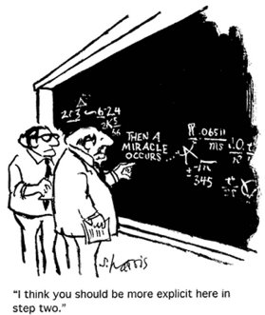
What is Theory of Change?
Slido: #298
Theory of Change (TOC) is a methodology for planning, monitoring, and evaluating any initiative. It enables the responsible team to clearly consider and highlight any complexities, and to agree these with relevant stakeholders.
It strengthens decision-making processes by ensuring all stakeholders are aligned and that you have identified existing evidence, assumptions, and associated risks.
TOC refers to both a planning process and the end-product of that process.
Notes:
Slido: Can you think of any situations in which people might use TOC?

Slide 6
A common Theory of Change
What else might prompt change?
Information is provided
Awareness and knowledge is raised
People change their behaviour (the way we want them to)
Why would they? Why should they?
But people don’t usually act on information...?
What else is going on in their lives?
www.intdevalliance.scot

Slide 7
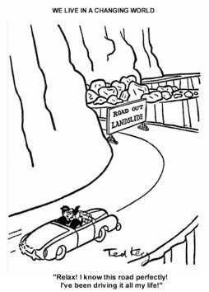
Make implicit assumptions explicit
Interventions operate within wider contexts​
What is the context in the real world?​
Are the directions of change linear? ​
What assumptions are being made about each element of the TOC?​
What evidence do you have to support these assumptions?​
What are the consequences if these assumptions are false?​
What are the rationales for all preconditions and activities

Slide 8
Factors affecting TOC approach
“Would you tell me, please, which way I ought to go from here?”
“That depends a good deal on where you want to get to.” ― Lewis Carroll, Alice in Wonderland
Purpose of TOC
Complexity and size of project
Stage of development
Availability of resources and timelines

Slide 9
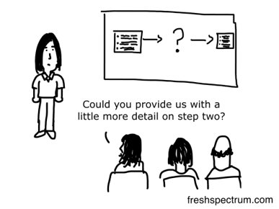
Why TOC?
Avoid implementing a mistake!

Slide 10
Why use TOC
When you produce a good TOC you will have:​
A clear description of what you want and the most efficient way of getting there​.
An agreement amongst your stakeholders about how they define success, what data should be collected, and when and how to measure success​.
A clear process to draw on existing evidence and theory about how change works in your specific context and identify any necessary assumptions. ​
A plan for monitoring and evaluation to help you identify the most useful lines of enquiries, understand what works, and learn from failures.​
A visual representation of the change you want to see​.
A powerful communication tool that captures the complex processes involved​
A framework that helps your funders understand how working with you will help them achieve their own objectives.

Slide 11
TOC component parts
Situation:
Inputs
Activities
Outputs
Outcomes
Impacts
Inputs include items such as financial inputs, people, skills, data and infrastructure / environment.
Activities that are associated with the policy or programme, use inputs and result in outputs.
Activities are of value only to the extent that they produce outputs.
Outputs are generally defined as the products of programme activities and are necessary for achieving the programme outcomes.
They can be thought of as tangible things and as direct output of policy or programme activities.
Outcomes are the end results of the policy or programme (expected or not, beneficial or not), that are within reach to influence and measure.
Impacts are the systematic change expected in the long-term and can take a few years to happen. They can be difficult to measure.
Problem:
Stakeholder(s):
Assumptions: Conditions that are necessary for the policy or programme to proceed / succeed and which are believed to be in place / valid.
External Factors: Variables that may influence a programme or project. They cannot be controlled by the policy or programme management
Adapted from Defra Theory of Change (ToC) Tool

Slide 12
TOC component parts continued
Inputs – Available resources. ​​
Activities - What you will need to do to provide a product or service. ​​
Outputs – The products, services, or facilities that will be how you achieve your outcomes​​.
Outcomes - The changes needed to achieve the impact​​.
Impacts – The long-term effect you would like your intervention to have​​.

Slide 13
TOC component parts exercise
Slido: #298
Improve reading proficiency among children in Grades 5-6 by 20% within 5 years
Financial services targeted at women and six specific products rolled out.
Engagement events and communications to increase awareness of the Violence Reduction Unit.
Building relationships with key stakeholders across government including the policy, analytical and finance community.
Funding, existing structures, people and partners, intelligence, and policies.
Notes:
Short term and long term examples needed
Slido: What TOC component is example A? - Impact
Slido: What TOC component is example B? - Outcome
Slido: What TOC component is example C? - Output
Slido: What TOC component is example D? - Activities
Slido: What TOC component is example E? - Inputs
Impacts – The long-term effect you would like your intervention to have​​
E.g., Poor and vulnerable people, especially women, benefit from economic growth in poorest states
Outcomes - The changes needed to achieve the impact​​
E.g. Financial services targeted at women and six specific products rolled out
Outputs – The products, services, or facilities that will be how you achieve your outcomes​​
E.g., ‘engagement events and communications to increase awareness of the Violence Reduction Unit’ ​​
Activities - What you will need to do to provide a product or service. ​​
E.g., ‘building relationships with key stakeholders across government including the policy, analytical and finance community’​​
Inputs – Available resources ​​
E.g., funding, existing structures, people and partners, intelligence, and policies.​

Slide 14
How to produce a TOC – Eleven steps to develop a TOC
Eleven steps to develop a Theory of Change (as outline in the Analysis TOC Toolkit).
1: Identify stake-holders and agree intended impact​
2: Collect evidence and establish context​
3: Identify impacts, or long-term goals​
4: Define your outcomes ​
5: Identify outputs and activities​
6: Identify inputs​
7: Clearly state your assumptions​
8: Identify risks​
9: Apply causal links​
Optional step: Include timelines and plan resources​
10: Produce your diagram and narrative​
11: Produce a monitoring and evaluation action plan

Slide 15
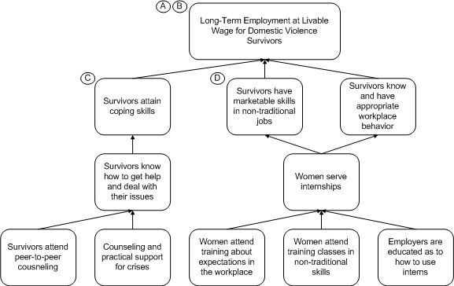
How to backward map
Try to ensure your outcomes are SMART:
Smart
Measurable
Achievable
Realistic
Time-bound
Backward mapping example

Slide 16
Backward mapping exercise
Slido: #298
Notes:
Slido: can you practice backward mapping for this long-term aim and tell us what needs to happen for this to take place?

Slide 17
Backward mapping exercise continued
Long term goal
20 % increase in the number of departments that use theory of change at the design stage of projects/programmes
Identify intermediate steps that need to happen for departments to achieve this goal working backwards
For this to happen departments need to …..

Slide 18
Nesta standards of evidence
Level 1: You can describe what you do and why it matters, logically, coherently and convincingly.
Level 2: You can capture data that shows positive change, but you cannot confirm you caused this
Level 3: You can demonstrate causality using a control or comparison group.
Level 4:You have one + independent replication evaluations that confirms these conclusions.
Level 5: You have manuals, systems, and procedures to ensure consistent replication.
Not all evidence is equal. Some are stronger and more relevant to your question
Nesta Standards of Evidence

Slide 19
TOC key principles
Meaningful Collaborative​
Engage Analysts to support you at the start of the process​
Comprehensive​
Backward map and connect preconditions to achieve intended​
Explain why preconditions are necessary and sufficient​
Provide supporting evidence​
Make assumptions and risks explicit​
Quality review to ensure TOC is plausible, feasible and testable​
Include a diagram and narrative to explain the logic​
Validate, revisit, update

Slide 20
Theory of Change: Financial Inclusion (45% of funds)
Inputs
Outputs 4: Women’s capacities to tackle gender constraints relating to business and the household enhanced.
Activities Participation
Outcomes
Short Long
Impact
GBP £6m (included in the overall financial component)
Management Agency SIDBI: PMU at New Delhi with Gender specailist
DFID:
Task Team Leader (0.5 FTE); Economists (0.1 FTE);
SD Advisor (0.5 FTE);
Governance Advisor (02 FTE);
Program Officer-A2L (0.5 FTE)
Research/studies: FINSCOPE Survey; Cost benefit data/ Sectoral studies; Product development
Financial services targeted at women and six specific products rolled out
Poor and vulnerable people, especially women, benefit from economic growth in poorest states, India Women able to travel outside place of residence without male escort (50% increase over control groups) 35% decrease malnourishment rate amongst children below 5 years over control groups
Financial products - savings, insurance, pension - developed, piloted & rolled out based on women’s needs; capacity of partners enhanced
70% of the clients will be poor or borderline poor (below $2 a day) especially women
Women gain self-esteem and self confidence
Increased decision making by women clients
Grant support to MFIs/SHPIs / NGOs/ training institutions through NABARD, SFMC/similar institutions
Providing access to financial products and services
Integrating gender issues in their micro finance programmes,
facilitate structured monthly discussions among the clients on social, gender and health issues
Financial literacy
0.3 mn women clients trained/ made aware of their rights, including as consumers of financial services on a) Financial literacy and b) Social, health & gender issues
EVIDENCE Linking:
Activities to short/ medium Outcome: Medium
‘Littlefield, Elizabeth, Jonathan Murdoch, and Syed Hashemi, “Is microfinance an effective strategy to reach the millennium development goals?” Focus Note 24, Washington, D.C.: CGAP, 2003; Vaill, S., 2003, ‘More than Money: Strategies to Build Women’s Economic Power, Impact Report No. 1: Economic Opportunity Initiative, The Global Fund for Women, San Francisco.
Outcome to Long-term Outcome/ Impact: Medium
Kim, J. C. et al., 2007, ‘Understanding the Impact of a Microfinance-Based Intervention on Women’s Empowerment and the Reduction of Intimate Partner Violence in South Africa’, American Journal of Public Health, vol. 97, no. 10, pp. 1794-1802 ; O'Rourke K, et.al., “Impact of community organization of women on perinatal outcomes in rural Bolivia.” Rev Panam Salud Publica 1998 3(1): 9-14.
Assumptions and External Factors
Low cost approaches to building capacities of women on financial and gender issues will be explored during the operational phase.
Partner MFIs/SHPIs show commitment and willingness to take forward the issue; go beyond the assumption that simply organising women into client groups addresses gender issues.
Women are able/willing to determine and prioritize social/ gender issues and needs.

Slide 21
How to produce a TOC - Resources
The Magenta Book
The Magenta Book provides a comprehensive overview of evaluation in government: its scoping, design, management, use and dissemination​
Magenta Book – Chapter 2.2​
Analysis Function Theory of Change toolkit​
The toolkit is aimed at non-experts, and includes information and case studies on how Theory of Change is applied in practice to the work of government​
Analysis Function Theory of Change Toolkit Link

Slide 22
What to avoid – TOC red flags
No buy in from key decision makers​
No agreement between departments on shared goals ​
No clarity on roles ​
No reference to good quality evidence​
No collaboration with analysts​
Outcomes too vague to inform decisions​
Preconditions not fleshed out to the initial long term goal​
Outcomes not in chronological order​
No follow up/updating process

Slide 23
Top tips for a good TOC
Is based on collaborative and participatory process​
Early collaboration with analysts​
Show clear logical flow that is testable​
Assured through development process​
Ensure consistent definitions ​
Meaningful participation ​
Genuine reflective process grounded in context ​
Refer to existing evidence from credible sources including evaluations previous policies​
Challenge and explain existing assumptions​
Develop SMART indicators to measure success​
Develop your TOC iteratively

Slide 24
Exercise – Practice TOC
Slido: #298
Can you identify any critical assumptions that need to be considered?
Inputs
Resources, people, money required.
Example: Cost of purchasing new tech.
Activities
Services and activities put in to support tech intervention.
Example: Tech training
Outputs
Direct effects that can be targeted and monitored.
Example: Software take up to one year later.
Outcomes
Impacts
Changes in behaviour, capacity, performance.
Example: Improved realisation rates; increased profit.
Changes in conditions that gave rise to the intervention.
Example: Thriving successful firm.
Notes:
Slido: Are there critcal assumptions that need to be considered?

Slide 25
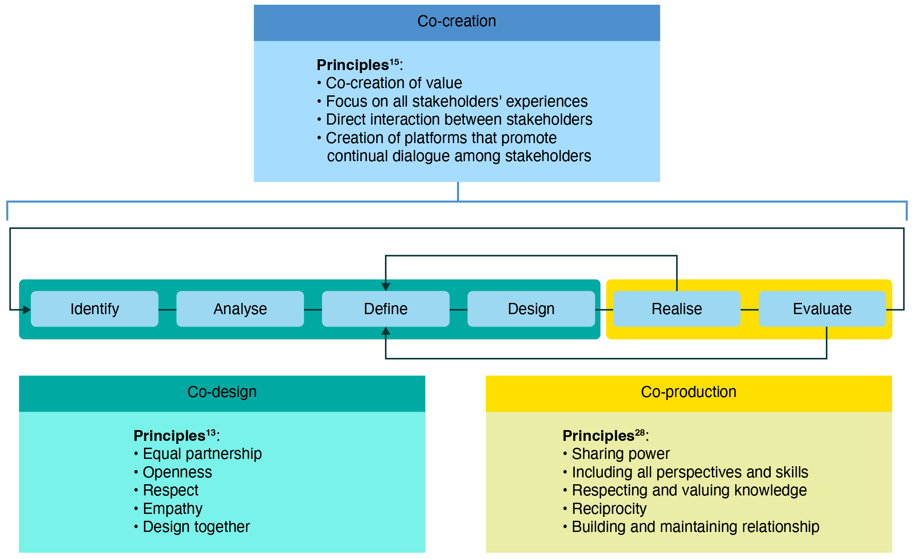
Co-creation engages stakeholders before the problem is defined
Model for co-creation of public health initiatives

Slide 26
Resources
Slido: #298
Visit the new Analysis Evaluation Support Page for more details​
The Theory of Change Process – Guidance for Outcome Delivery Plans – Government Analysis Function (civilservice.gov.uk)
Defra Theory of Change Toolkit
Early Intervention Foundation blog on “Using workshops to develop a theory of change: experiences and examples from our work with four local early help teams”​
‘Appendix 3: Examples of Theories of Change’ on GOV.UK ​
Report on Supporting Emergency Needs, Early Recovery and Longer-term Resilience in Syria’s Agriculture Sector (Endline Report 2021)
Public Health Research and Practice article on “Co-creation, co-design, co-production for public health – a perspective on definitions and distinctions”
Notes:
Slido: What would be your top training need for TOC?

Slide 27
Any questions?

Slide 28
Thank you Please check out the rest of our content at the AiG Month 23 Hub

