Slide 1
Making charts more accessible
Hannah Thomas
Lead support for communicating data, statistics and analysis
3 May 2023

Slide 2
Hello
My name is Hannah Thomas
I am the lead support for communicating data stats and analysis across the Government Analysis Function, which includes anyone who works with analysis across government.
We provide guidance, support and community building opportunities to help people across government improve how they communicate their data, statistics or analysis.
Today I am going to talk about making charts accessible. I am going to do a couple of demonstrations using real life charts that a few teams have been generous enough to provide.

Slide 3
Digital accessibility
Digital accessibility is all about making content published online easy to access and use for all users, regardless of impairment, medical condition or disability.
For anyone who publishes on a public sector website it is a legal requirement to pass certain accessibility success criterion.
This can mean blind people, people with low vision, people with colourblindness, deaf people or people with hearing impairments, people with cognitive impairments, neurodiverse people, people who cannot use a mouse so only use keyboards for navigation, and so on - accessibility needs are wide ranging.

Slide 4
Rule
All content published on public sector
websites must meet the level A and AA
success criterion in the
Web Content Accessibility Guidelines 2.1

Slide 5
How this relates to charts

Slide 6
Colours

Slide 7
Colours in charts

Slide 8
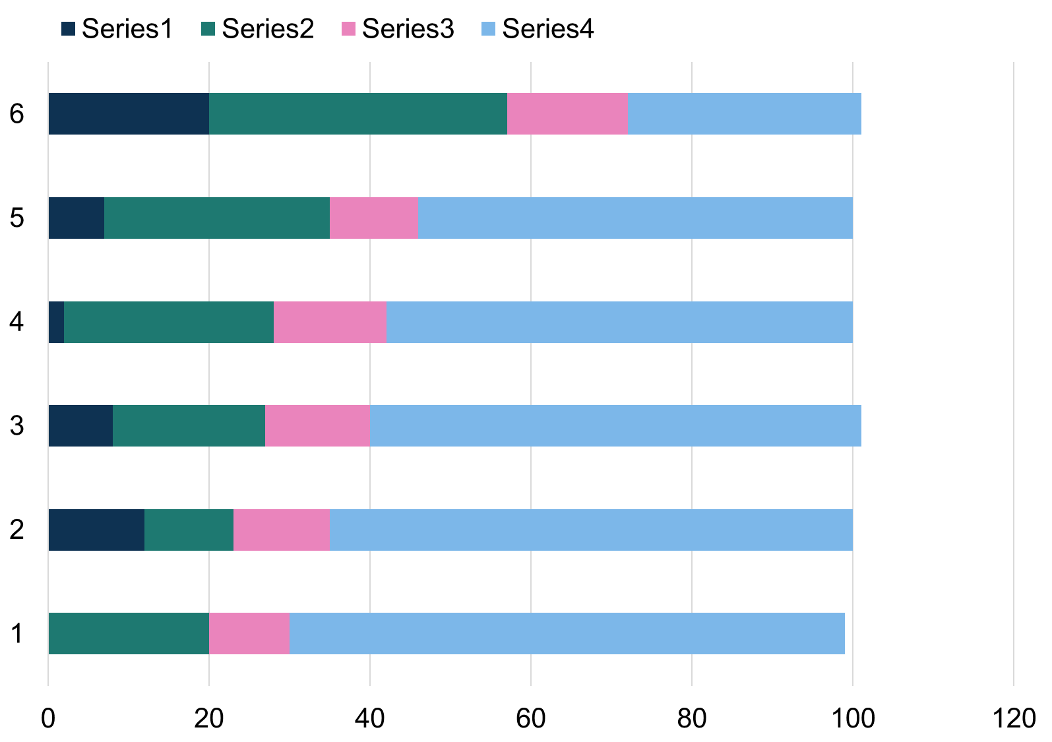
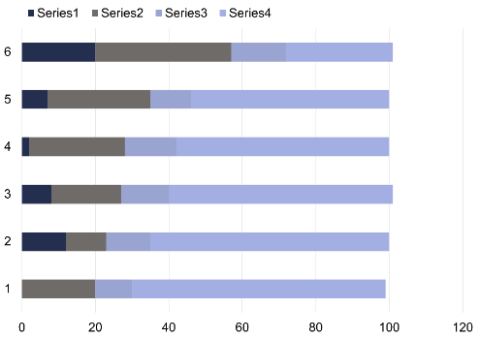
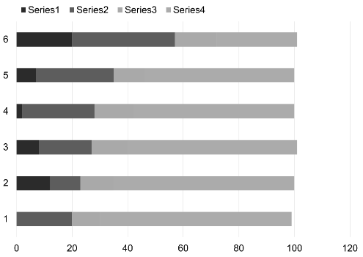
Colours in charts – comparison

Slide 9
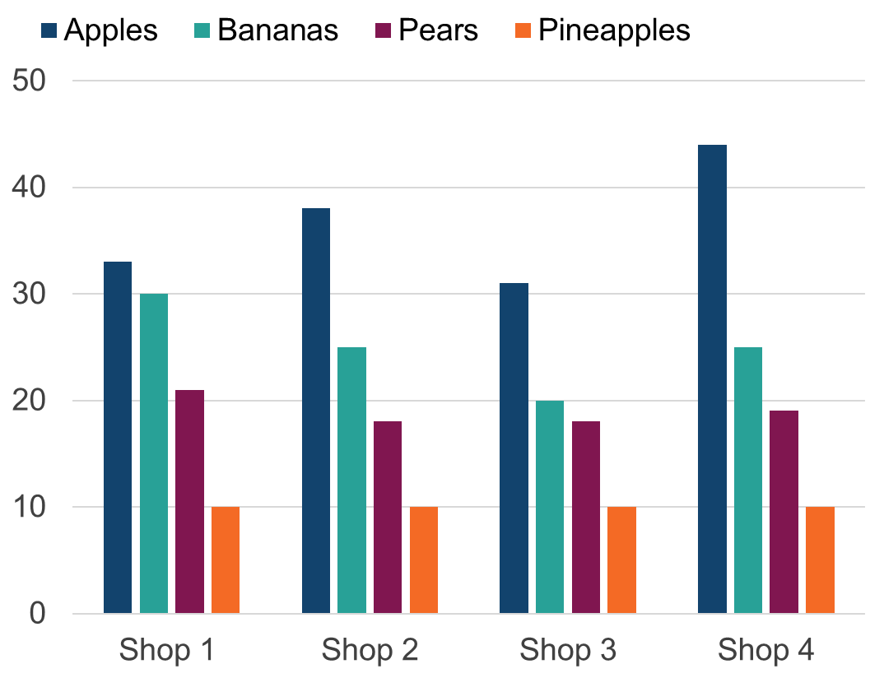
Colours in charts - legends

Slide 10
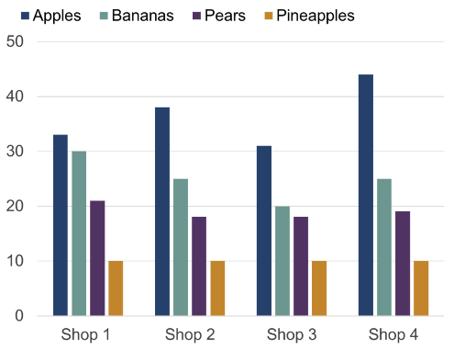
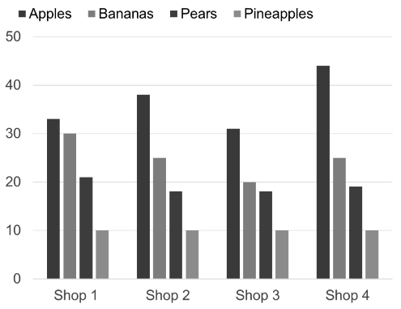
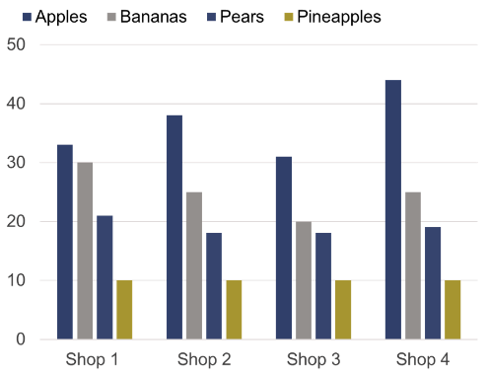
Colours in charts – legends comparison
Colour blindness simulator

Slide 11
Alternative text

Slide 12
Example
Figure 1: European and North American residents helped to push visits to the UK in May 2022 up higher than the previous year
Overseas residents’ visits to the UK by month, January 2018 to May 2022
Source: International Passenger Survey from the Office for National Statistics
Download this chart

Slide 13
Example: vague alternative text
Figure 1: European and North American residents helped to push visits to the UK in May 2022 up higher than the previous year
Overseas residents’ visits to the UK by month, January 2018 to May 2022
Image of line chart showing overseas residents
visits UK Jan 2018 to May 2022
Source: International Passenger Survey from the Office for National Statistics
Download this chart

Slide 14
Example: data download

Slide 15
Example: data download read out by screen reader software
A1 wrap text Figure 1: European and North American residents helped to push visits to the UK in May 2022 up higher than the previous year
A2 Overseas residents’ visits to the UK by month, January 2018 to May 2022
Blank A3, Blank B3, Blank C3, A4 Notes A5 Unit A6 Blank A7 Blank A8 Jan-18 A7 Blank
B7 All visits (thousands) C7 North America (thousands) D7 Europe (thousands) E7 Other countries (thousands)
A8 Jan 18 B8 2734 C8 321 D8 1790 E8 623 F8 BLANK G8 BLANK A9 Feb 18 B9 2573 C9 262 D9 1870 E9440
A10 Mar 18 B10 3240 C10 354 D10 2405 E10 480 A11 Apr 18 B11 3404 C11 453 D11 2423 E11528

Slide 16
Example: low vision

Slide 17
Example: user cannot interpret charts
Figure 1: European and North American residents helped to push visits to the UK in May 2022 up higher than the previous year
Overseas residents’ visits to the UK by month, January 2018 to May 2022
Source: International Passenger Survey from the Office for National Statistics
Download this chart

Slide 18
Quick exercise

Slide 19
Exercise: detailed text description
Figure 1: European and North American residents helped to push visits to the UK in May 2022 up higher than the previous year
Overseas residents’ visits to the UK by month, January 2018 to May 2022
A line chart showing visits fell sharply to very low levels in April 2020 due to the coronavirus (COVID-19) pandemic.
Visits from North American residents have remained low since then. But they have increased in recent months, standing at 420,000 in May 2022, not far below pre-pandemic levels for May.
Visits from European residents rose slightly towards the end of 2020 before falling back. In July 2021 they started rising again. In May 2022, there were 2,000,000 visits, nearing pre-pandemic levels for this time of year.
Exercise:
Try to sketch what you think the chart looks like from this information

Slide 20
Exercise: detailed text description - rank
Figure 1: European and North American residents helped to push visits to the UK in May 2022 up higher than the previous year
Exercise:
Now you can see the chart, rate how good your sketch was
Overseas residents’ visits to the UK by month, January 2018 to May 2022
A line chart showing visits fell sharply to very low levels in April 2020 due to the coronavirus (COVID-19) pandemic.
Visits from North American residents have remained low since then. But they have increased in recent months, standing at 420,000 in May 2022, not far below pre-pandemic levels for May.
Visits from European residents rose slightly towards the end of 2020 before falling back. In July 2021 they started rising again. In May 2022, there were 2,000,000 visits, nearing pre-pandemic levels for this time of year.

Slide 21
Other formatting rules

Slide 22
Exercise 1: Which is more accessible?
1
2

Slide 23
Exercise 1 answer
1
2

Slide 24
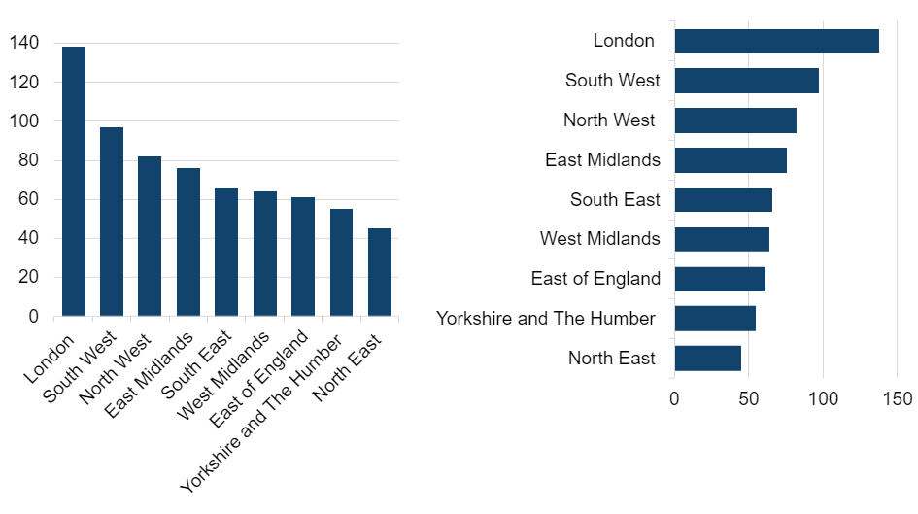
Exercise 2: Which is more accessible?
1
2

Slide 25
Exercise 2 answer
1
2

Slide 26
Exercise 3: Which is more accessible?
1
2

Slide 27
Exercise 3 answer
1
2

Slide 28
Best practice example

Slide 29
Best practice example – baby names
Headline title and statistical title in the body text of the page
SVG image – chart is uncluttered, no wonky text and only a few light grey gridlines
Alternative text giving equivalent experience to looking at the chart – this is in the body text and it immediately follows the chart image
Information on source with a link
Accessible data download provided in an open format.
Short footnotes come last, under heading of ‘Notes’. Only used when necessary.

Slide 30
Demonstrations

Slide 31
Crime statistics example

Slide 32
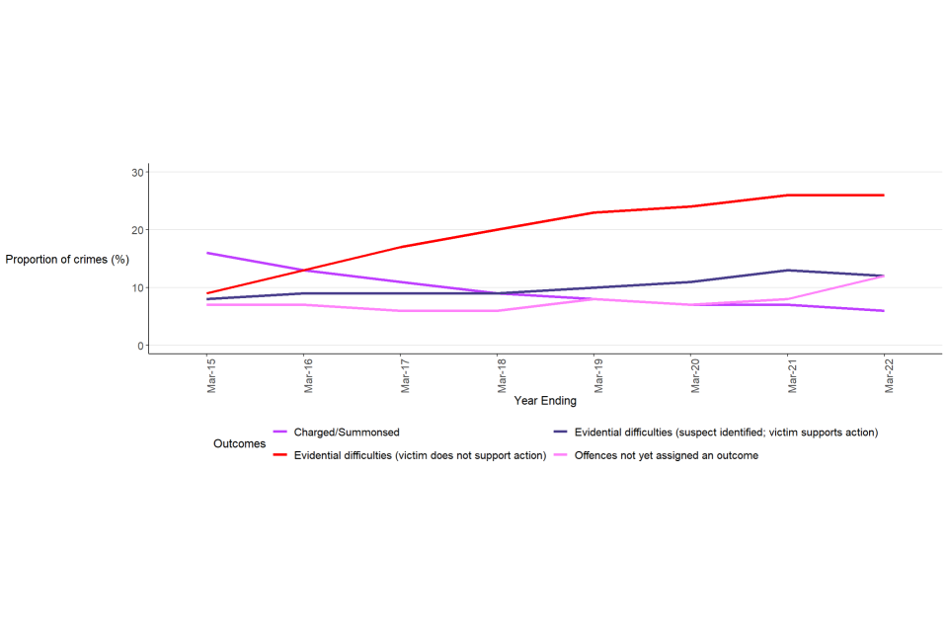
Crime statistics: example
Proportion of offences resulting in a charge and/or summons or evidential difficulties outcome, or where an outcome is yet to be assigned, year ending March 2015 to year ending March 2022, England and Wales

Slide 33
Crime statistics: example - pointers
Pointers
Accessibility
Colours
Stretched
PNG format
Perpendicular text
Legend
Start title with “Figure”
Best practice
Focus on message
Edit title
Use % instead of label on y-axis
Proportion of offences resulting in a charge and/or summons or evidential difficulties outcome, or where an outcome is yet to be assigned, year ending March 2015 to year ending March 2022, England and Wales

Slide 34
Crime statistics: example – suggested alternative
Rise in victims not supporting action
Figure x: Proportion of offences resulting in an evidential difficulties outcome, England and Wales, year ending March 2015 to year ending March 2022
Evidential difficulties: victim does not support action
Evidential difficulties: Suspect identified and victim supports action

Slide 35
Crime statistics: example – suggested alternative with alt text
Rise in victims not supporting action
Figure x: Proportion of offences resulting in an evidential difficulties outcome, England and Wales, year ending March 2015 to year ending March 2022
Evidential difficulties: victim does not support action
Evidential difficulties: Suspect identified and victim supports action
Alternative text
A line chart with two lines. One shows a rise in the proportion of evidential difficulties outcomes where the victim does not support action from around 9% to around 26%. The other shows a smaller rise in the proportion of evidential difficulties outcomes where the suspect is identified and the victim supports action (from around 8% to around 12%)

Slide 36
Crime statistics: example – stacked bar
Figure x: Outcomes for offences, England and Wales, year ending March 2015 to year ending March 2022
Legend is presented in the same order as the stacks in the bars

Slide 37
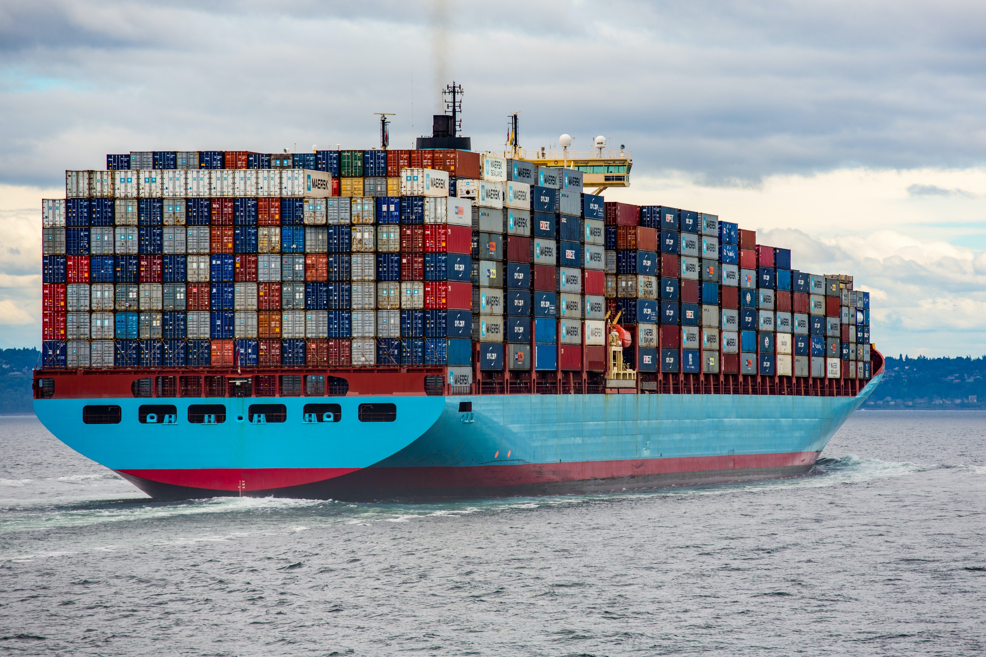
Trade bubble chart example

Slide 38
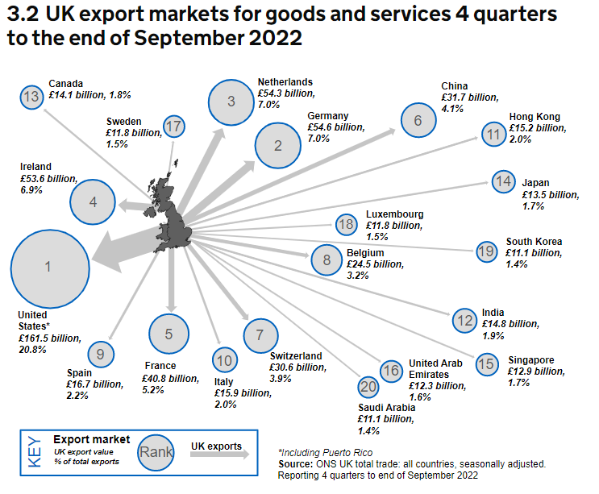
Trade: bubble chart example

Slide 39
Trade: bubble chart example - pointers
Pointers
Accessibility
Colours
Italic text
Start title with “Figure”
Do not put source only in image
Use of key
Best practice
Bars better than circles for comparison
Title should say what data is
4 quarters is 1 year?

Slide 40
Circle comparison
Rank these from largest to smallest:

Slide 41
Bar comparison
Rank these from largest to smallest:

Slide 42
Circle and bar comparison

Slide 43
Trade bubble chart – suggested alternative
Figure 3.2: Value of UK exports of goods and services for largest 18 export markets, year ending September 2022

Slide 44
Trade bubble chart – suggested alternative with alt text
Figure 3.2: Value of UK exports of goods and services for largest 18 export markets, year ending September 2022
Alternative text
Country | Value of UK exports of goods and services, year ending Sept 2022 (£Billion)
USA (inc Puerto Rico) | 161.5
Germany | 54.6
Netherlands | 54.3
Ireland | 53.6
France | 40.8
China | 31.7
Switzerland | 30.6
Belgium | 24.5
Spain | 16.7
Italy | 15.9
Hong Kong | 15.2
India | 14.8
Canada | 14.1
Japan | 13.5
Singapore | 12.9
Unite Arab Emirates | 12.3
Sweden | 11.8
Luxembourg | 11.8

Slide 45
Thank you
analysisfunction.civilservice.gov.uk/support/communicating-analysis/
Hannah.D.Thomas@ons.gov.uk
@statshan

