Slide 1
Communicating analysis effectively: three perspectives
Tom Whipple
The Times
Anna Khoo
Office for National Statistics
Hannah Thomas
Analysis Function Central Team
25 May 2023

Slide 2
Perspective one
Anna Khoo
Office for National Statistics
25 May 2023

Slide 3
Data journalism and audience accessibility
Writing for my mum about statistics she’s reading in the paper (and other things)
Anna Khoo
Data Journalism
Office for National Statistics

Slide 4
My mum (busy, interested member of the public)
Time poor
Reads on mobile
Consumes data content mostly via media (and me)
Has a lot of sensible questions
Well-educated, intelligent and curious
Has no idea about credible intervals etc

Slide 5
Technical language my mum doesn’t get
‘Confidence intervals’: morale-improving fitness training stints
‘Index’: at the back of a book
‘Breakdown by age’: what my car does
‘Decomposition analysis’: watching things rot
‘Spatiotemporal model’: a toy TARDIS

Slide 6
How to help your reader with technical terms
Avoid: Use simpler words
Buffer: Readable without understanding that term
Contain: Put technical detail somewhere else
(sub-section, drop-down, tool-tip, methodology)
Define: Explain briefly, ‘this is called/is where…’
Explain: Talk through it in detail, maybe with examples
Format: Use your headers, labels, lists, charts

Slide 7
Simpler alternative language
Fictional example:
Spatiotemporal modelling at LAD level continues to show a high variance in death rates after adjustments for general health state and population density.
We looked at deaths over time and by local authority district. Accounting for general health in each area and population density, there were still large differences in death rates.

Slide 8
Helping people through denser detail (Buffer)
'Price rises for food and non-alcoholic drinks are having the greatest effect on record when it comes to driving up the overall inflation rate, with a 1.51 percentage point contribution in November 2022, the largest contribution since the start of the National Statistics series in 2006.'
(emphasis added on main information)
Main message, then detail
Frontloaded sentence highlights paragraph focus on a skim read
Once we know what's going on, technical stuff smuggled in the middle
Longer data source detail and less important context towards the end
Who are the children entering care in England?

Slide 9
Example – simple definitions
Deprived backgrounds
Around 8 in 10 children (81%) who went into care for the first time after the 2011 Census were living in a household that was deprived in at least one dimension, compared with 50% among those who did not go into care.
A household is considered as deprived if it meets at least one of the following criteria over four dimensions:
Employment deprivation is where any household member, who is not a full-time student, is either unemployed or long-term sick
Education deprivation is where no household member has a Level 2 qualification (for example, GCSE at grades A* to C or equivalent) and no person aged 16 to 18 years is a full-time student
Section header gives context (Format)
‘Around 8 in 10’ is easier than 81% (Alternative)
First sentence makes sense without understanding ‘deprivation dimensions’ (Buffer)
Link from term to methodology (Contain)
Full definition immediately after main finding (Define/Explain)
Bullet list for legibility (and less scary) (Format)
Who are the children entering care in England?

Slide 10
Example – caveats in conversational tone
Section header gives main point on skim read (Format)
‘This is complicated’. Caveats and nuances coming next, it’s all useful and interesting and worth your time.
Explanation of what a technical term means before we introduce it so that’s not terrifying. (Define)
Link from term to methodology (Contain)
Retail, hospitality and arts and recreation industries among worst affected by coronavirus lockdowns
Industries that experienced the most disruption to the workforce during the coronavirus (COVID-19) pandemic, such as retail, hospitality, and arts and entertainment, have seen large swings in average pay and pay growth over recent years. This makes understanding trends in wage growth more complicated.
One factor that affected average wages during the coronavirus pandemic was workforce composition. A relatively large amount of low paid workers lost their jobs, which pushes up average wages even if no workers received pay rises. This is known as a compositional effect.
Professional and scientific industry the only one where pay continues to match rising prices

Slide 11
Findings before methodology
Some people don’t need to know how you did it to understand why it’s important. That’s fine.
Areas with strong local businesses and adult education tended to have lower rates of loneliness, modelling found that local authorities in London particularly benefit from these.
Regression analysis
Mapping loneliness during the coronavirus pandemic

Slide 12
Unpacking models
Spelling it all out is worth it sometimes.
This means that, if a person who was eligible for free school meals as a child had had the same level of education, KS4 attainment, years of labour market experience, ethnicity, and went to secondary school in the same region as a person who attended an independent school, the model predicts that on average they would still earn around 20% less than that of an independent school student. That result was true for men and women.
Why free school meal recipients earn less than their peers

Slide 13
Reducing the odds of misinterpretation
"Students at lower-rated schools have 11% higher odds of going on to be imprisoned compared with students at higher-rated schools."
11% more students?!
Qualify with absolute scale:
"Students at lower-rated schools have 11% higher odds of going on to be imprisoned compared with students at higher-rated schools. In practice, a very small number of people go on to receive an immediate custodial sentence, so this is a difference of about 1 in 1,000 students.
https://www.ons.gov.uk/peoplepopulationandcommunity/educationandchildcare/articles/thelinksbetweenyoungpeoplebeingimprisonedpupilbackgroundandschoolquality/2023-01-27

Slide 14
Demo the model with an example person
The likelihood of imprisonment also varies for people depending on situation and characteristics. There is no “average” student, but we can pick some characteristics for a person to put in the model and show the school quality effect for them as a reference.
Our reference student is male, White British, and had average educational attainment. They have English as a first language, they do not have any Special Educational Needs and are not eligible for free school meals, they were not in care, they are born around the middle of the academic year, and they go to a mixed comprehensive, non-religious school in a rural village in the East Midlands. The school has average characteristics in terms of its size and the type of pupils who go there.
For this student, there is a 1.4% chance (nearly 14 people in every 1,000) that they will go on to be imprisoned if they go to an outstanding or good school. If they went to a satisfactory or inadequate school however, they would have a 1.5% (15 people in every 1,000) chance of imprisonment, even if everything else stayed the same.
Conversational caveating.
Explain the issue openly. Absolute chances are all different (Logistic regression, but we won't go into that)
Demo example.
Imagine this person. Reminds us of all the controlled factors in this model within a personal sketch.
Concrete absolute odds, 'this many people'.
Technically covers off the '1 in 1000 people' from earlier (specific to male, etc).
The links between young people being imprisoned, pupil background and school quality

Slide 15
Now imagine what the model would do if...
There are 500,000 real-life people in this dataset, (thanks demo dude, bye now!).
In the following sections, we show how the likelihood of imprisonment is higher for people in disadvantaged situations and that some students are much less likely to attend a good or outstanding school.
The links between young people being imprisoned, pupil background and school quality

Slide 16
Engaging a public audience
Be topical, listen to what people are asking/assuming
Regularly updated summaries (Cost of living latest insights)
News style articles
Make it human, we care about people
Personalise it (How your area has changed in 10 years: Census 2021)
How this affects them (Shopping prices comparison tool, Personal inflation calculator)
Quotes to ground numbers in personal experiences (Living longer lives)
Invite curiosity, people want to immerse themselves
Explanatory visual walk-throughs (‘Scrolly’ article on local income deprivation)
Easy to use tools (Census maps)
Games (Census 2021 quiz: how well do you know your area?)
More project examples from ONS Digital Content: https://onsvisual.github.io/project_cairo

Slide 17
Perspective two
Tom Whipple
The Times
25 May 2023

Slide 18
Cookies

Slide 19
Dinosaurs

Slide 20
Snake

Slide 21
The Sun headline

Slide 22
Newspaper article 1

Slide 23
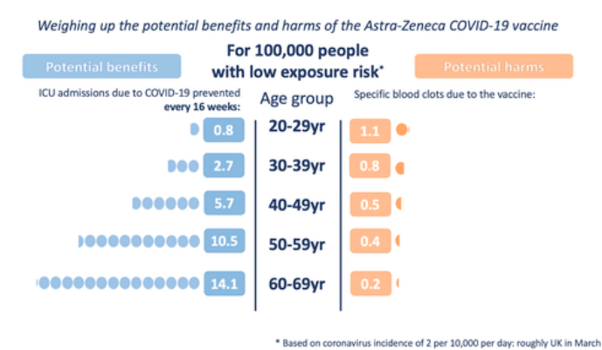
Benefits and harms of Astra-Zeneca vaccine
Link to web version of this article

Slide 24
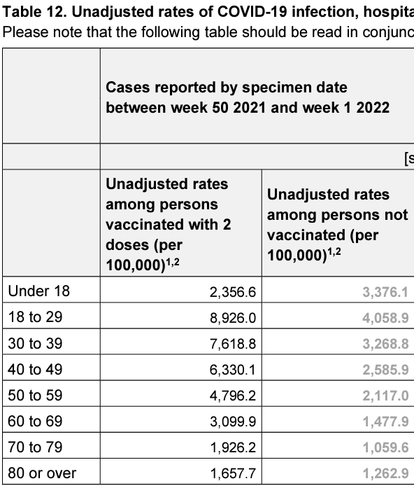
Rates of Covid-19 infection

Slide 25
Joe Rogan experience logo

Slide 26
Man in suit

Slide 27
Flatulence table

Slide 28
Lid, lash and lacrimal table

Slide 29
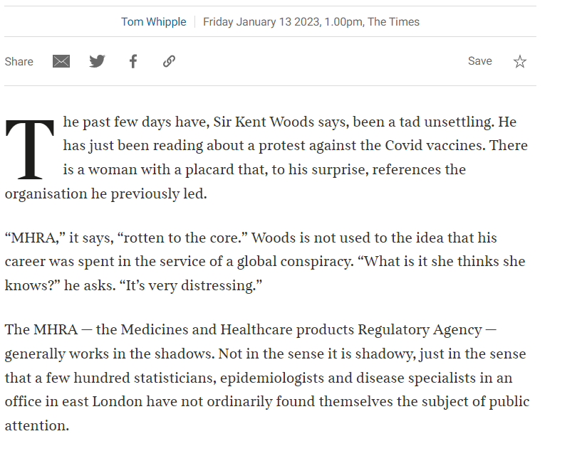
Article 2

Slide 30
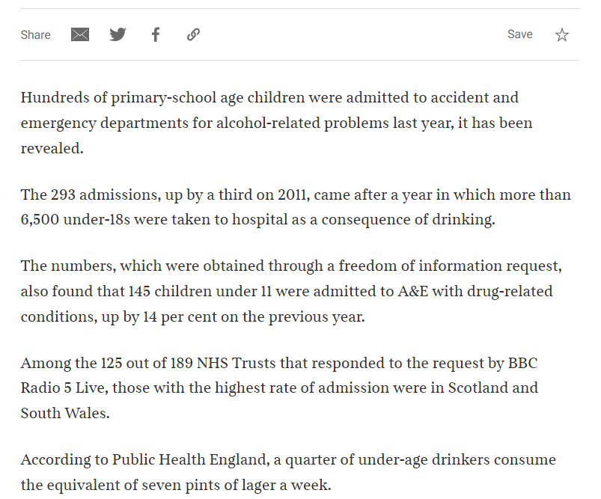
Article 3

Slide 31
Perspective three
Hannah Thomas
Analysis Function Central Team
25 May 2023

Slide 32
Hello

Slide 33
Usually at the start of an analytical publication Often the only part that gets read One sentence per bullet point Max 6 points
Main points

Slide 34
Census language publication

Slide 35
Main points 1
Language, England and Wales: Census 2021
Main language, English language proficiency, and household language in England and Wales, Census 2021 data.
1.Main points
In 2021, 91.1% (52.6 million) of usual residents, aged three years and over, had English (English or Welsh in Wales) as a main language (down from 92.3%, or 49.8 million, in 2011).

Slide 36
Main points 2
Language, England and Wales: Census 2021
Main language, English language proficiency, and household language in England and Wales, Census 2021 data.
1.Main points
In 2021, 91.1% (52.6 million) of usual residents, aged three years and over, had English (English or Welsh in Wales) as a main language (down from 92.3%, or 49.8 million, in 2011).
91.1% (52.6 million) of usual residents, aged three years and over, stated “English” or “English or Welsh” as their main language, compared with 92.3% (49.8 million) in 2011.

Slide 37
Main points 3
Language, England and Wales: Census 2021
Main language, English language proficiency, and household language in England and Wales, Census 2021 data.
1.Main points
In 2021, 91.1% (52.6 million) of usual residents, aged three years and over, had English (English or Welsh in Wales) as a main language (down from 92.3%, or 49.8 million, in 2011).
91.1% (52.6 million) of usual residents, aged three years and over, stated “English” or “English or Welsh” as their main language, compared with 92.3% (49.8 million) in 2011.

Slide 38
Main points 4
Language, England and Wales: Census 2021
Main language, English language proficiency, and household language in England and Wales, Census 2021 data.
1.Main points
In 2021, 91.1% (52.6 million) of usual residents, aged three years and over, had English (English or Welsh in Wales) as a main language (down from 92.3%, or 49.8 million, in 2011).
91.1% (52.6 million) of usual residents, aged three years and over, stated “English” or “English or Welsh” as their main language, compared with 92.3% (49.8 million) in 2011.
In 2021, a further 7.1% (4.1 million) of the overall population were proficient in English (English or Welsh in Wales) but did not speak it as their main language.

Slide 39
Main points 5
Language, England and Wales: Census 2021
Main language, English language proficiency, and household language in England and Wales, Census 2021 data.
1.Main points
In 2021, 91.1% (52.6 million) of usual residents, aged three years and over, had English (English or Welsh in Wales) as a main language (down from 92.3%, or 49.8 million, in 2011).
91.1% (52.6 million) of usual residents, aged three years and over, stated “English” or “English or Welsh” as their main language, compared with 92.3% (49.8 million) in 2011.
In 2021, a further 7.1% (4.1 million) of the overall population were proficient in English (English or Welsh in Wales) but did not speak it as their main language.
Most people (79.7%) who do not have “English” or “English or Welsh” as a main language speak English “Well” or “Very well”.

Slide 40
Main points 6
Language, England and Wales: Census 2021
Main language, English language proficiency, and household language in England and Wales, Census 2021 data.
1.Main points
In 2021, 91.1% (52.6 million) of usual residents, aged three years and over, had English (English or Welsh in Wales) as a main language (down from 92.3%, or 49.8 million, in 2011).
91.1% (52.6 million) of usual residents, aged three years and over, stated “English” or “English or Welsh” as their main language, compared with 92.3% (49.8 million) in 2011.
In 2021, a further 7.1% (4.1 million) of the overall population were proficient in English (English or Welsh in Wales) but did not speak it as their main language.
Most people (79.7%) who do not state “English” or “English or Welsh” as a main language can speak English “Well” or “Very well”
The most common main languages, other than English (English or Welsh in Wales), were: Polish (1.1%, 612,000), Romanian (0.8%, 472,000), Panjabi (0.5%, 291,000), and Urdu (0.5%, 270,000).

Slide 41
Main points 7
Language, England and Wales: Census 2021
Main language, English language proficiency, and household language in England and Wales, Census 2021 data.
1.Main points
In 2021, 91.1% (52.6 million) of usual residents, aged three years and over, had English (English or Welsh in Wales) as a main language (down from 92.3%, or 49.8 million, in 2011).
91.1% (52.6 million) of usual residents, aged three years and over, stated “English” or “English or Welsh” as their main language, compared with 92.3% (49.8 million) in 2011.
In 2021, a further 7.1% (4.1 million) of the overall population were proficient in English (English or Welsh in Wales) but did not speak it as their main language.
Most people (79.7%) who do not state “English” or “English or Welsh” as a main language can speak English “Well” or “Very well”
The most common main languages, other than English (English or Welsh in Wales), were: Polish (1.1%, 612,000), Romanian (0.8%, 472,000), Panjabi (0.5%, 291,000), and Urdu (0.5%, 270,000).
Of the other main languages specified, the most common were: Polish (1.1%, 612,000), Romanian (0.8%, 472,000) and Panjabi (0.5%, 291,000)

Slide 42
Main points 8
1.Main points
In 2021, 91.1% (52.6 million) of usual residents, aged three years and over, had English (English or Welsh in Wales) as a main language (down from 92.3%, or 49.8 million, in 2011).
91.1% (52.6 million) of usual residents, aged three years and over, stated “English” or “English or Welsh” as their main language, compared with 92.3% (49.8 million) in 2011.
In 2021, a further 7.1% (4.1 million) of the overall population were proficient in English (English or Welsh in Wales) but did not speak it as their main language.
Most people (79.7%) who do not state “English” or “English or Welsh” as a main language can speak English “Well” or “Very well”
The most common main languages, other than English (English or Welsh in Wales), were: Polish (1.1%, 612,000), Romanian (0.8%, 472,000), Panjabi (0.5%, 291,000), and Urdu (0.5%, 270,000).
Of the other main languages specified, the most common were: Polish (1.1%, 612,000), Romanian (0.8%, 472,000) and Panjabi (0.5%, 291,000).
The largest increase was for people who specified Romanian as a main language, who accounted for over 0.8% of usual residents in 2021 (472,000 people), up from 0.1% (68,000) in 2011.

Slide 43
Main points 9
1.Main points
In 2021, 91.1% (52.6 million) of usual residents, aged three years and over, had English (English or Welsh in Wales) as a main language (down from 92.3%, or 49.8 million, in 2011).
91.1% (52.6 million) of usual residents, aged three years and over, stated “English” or “English or Welsh” as their main language, compared with 92.3% (49.8 million) in 2011.
In 2021, a further 7.1% (4.1 million) of the overall population were proficient in English (English or Welsh in Wales) but did not speak it as their main language.
Most people (79.7%) who do not state “English” or “English or Welsh” as a main language can speak English “Well” or “Very well”
The most common main languages, other than English (English or Welsh in Wales), were: Polish (1.1%, 612,000), Romanian (0.8%, 472,000), Panjabi (0.5%, 291,000), and Urdu (0.5%, 270,000).
Of the other main languages specified, the most common were: Polish (1.1%, 612,000), Romanian (0.8%, 472,000) and Panjabi (0.5%, 291,000).
The largest increase was for people who specified Romanian as a main language, who accounted for over 0.8% of usual residents in 2021 (472,000 people), up from 0.1% (68,000) in 2011.
The largest increase was for people who specified Romanian, 0.8% (472,000) in 2021, up from 0.1% (68,000) in 2011.

Slide 44
Main points 10
1.Main points
In 2021, 91.1% (52.6 million) of usual residents, aged three years and over, had English (English or Welsh in Wales) as a main language (down from 92.3%, or 49.8 million, in 2011).
91.1% (52.6 million) of usual residents, aged three years and over, stated “English” or “English or Welsh” as their main language, compared with 92.3% (49.8 million) in 2011.
In 2021, a further 7.1% (4.1 million) of the overall population were proficient in English (English or Welsh in Wales) but did not speak it as their main language.
Most people (79.7%) who do not state “English” or “English or Welsh” as a main language can speak English “Well” or “Very well”
The most common main languages, other than English (English or Welsh in Wales), were: Polish (1.1%, 612,000), Romanian (0.8%, 472,000), Panjabi (0.5%, 291,000), and Urdu (0.5%, 270,000).
Of the other main languages specified, the most common were: Polish (1.1%, 612,000), Romanian (0.8%, 472,000), Panjabi (0.5%, 291,000), and Urdu (0.5%, 270,000).
The largest increase was for people who specified Romanian as a main language, who accounted for over 0.8% of usual residents in 2021 (472,000 people), up from 0.1% (68,000) in 2011.
The largest increase was for people who specified Romanian, 0.8% (472,000) in 2021, up from 0.1% (68,000) in 2011.
In 2021, 63.8% (15.8 million) of households consisted of members who all had the same main language; 6.0% (1.5 million) had different main languages within the household.

Slide 45
Main points 11
1.Main points
In 2021, 91.1% (52.6 million) of usual residents, aged three years and over, had English (English or Welsh in Wales) as a main language (down from 92.3%, or 49.8 million, in 2011).
91.1% (52.6 million) of usual residents, aged three years and over, stated “English” or “English or Welsh” as their main language, compared with 92.3% (49.8 million) in 2011.
In 2021, a further 7.1% (4.1 million) of the overall population were proficient in English (English or Welsh in Wales) but did not speak it as their main language.
Most people (79.7%) who do not state “English” or “English or Welsh” as a main language can speak English “Well” or “Very well”
The most common main languages, other than English (English or Welsh in Wales), were: Polish (1.1%, 612,000), Romanian (0.8%, 472,000), Panjabi (0.5%, 291,000), and Urdu (0.5%, 270,000).
Of the other main languages specified, the most common were: Polish (1.1%, 612,000), Romanian (0.8%, 472,000), Panjabi (0.5%, 291,000), and Urdu (0.5%, 270,000).
The largest increase was for people who specified Romanian as a main language, who accounted for over 0.8% of usual residents in 2021 (472,000 people), up from 0.1% (68,000) in 2011.
The largest increase was for people who specified Romanian, 0.8% (472,000) in 2021, up from 0.1% (68,000) in 2011.
In 2021, 63.8% (15.8 million) of households consisted of members who all had the same main language; 6.0% (1.5 million) had different main languages within the household.
6.0% of households had different main languages within the household.

Slide 46
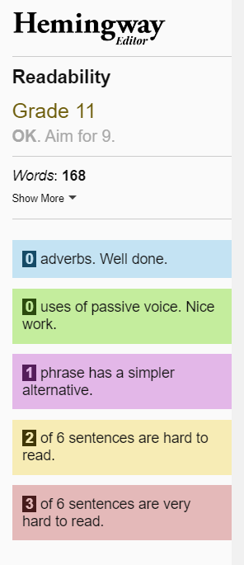
Main points 12
1.Main points (original)
In 2021, 91.1% (52.6 million) of usual residents, aged three years and over, had English (English or Welsh in Wales) as a main language (down from 92.3%, or 49.8 million, in 2011).
In 2021, a further 7.1% (4.1 million) of the overall population were proficient in English (English or Welsh in Wales) but did not speak it as their main language.
The most common main languages, other than English (English or Welsh in Wales), were: Polish (1.1%, 612,000), Romanian (0.8%, 472,000), Panjabi (0.5%, 291,000), and Urdu (0.5%, 270,000).
The largest increase was for people who specified Romanian as a main language, who accounted for over 0.8% of usual residents in 2021 (472,000 people), up from 0.1% (68,000) in 2011.
In 2021, 63.8% (15.8 million) of households consisted of members who all had the same main language; 6.0% (1.5 million) had different main languages within the household.

Slide 47
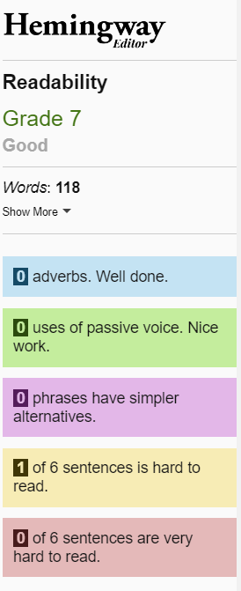
Main points 13
1.Main points (edited)
91.1% (52.6 million) of usual residents, aged three years and over, stated “English” or “English or Welsh” as their main language, compared with 92.3% (49.8 million) in 2011.
Most people (79.7%) who do not state “English” or “English or Welsh” as a main language can speak English “Well” or “Very well”
Of the other main languages specified, the most common were: Polish (1.1%, 612,000), Romanian (0.8%, 472,000), Panjabi (0.5%, 291,000), and Urdu (0.5%, 270,000).
The largest increase was for people who specified Romanian, 0.8% (472,000) in 2021, up from 0.1% (68,000) in 2011.
6.0% of households had different main languages within the household.

Slide 48
Fractions? Percentages? 1 in 10, 1 in 7, 1 in 100?
Making comparisons

Slide 49
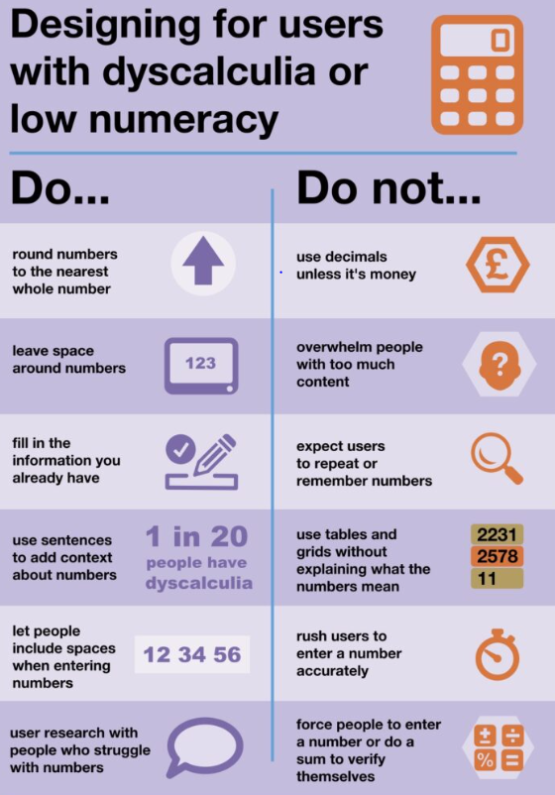
Dyscalculia

Slide 50
Designing for users with dyscalculia or low numeracy
Do | Do not
Round numbers to the nearest whole number | Use decimals unless it’s money
Leave space around numbers | Overwhelm people with too much content
Fill in the information you already have | Expect users to repeat or remember numbers
Use sentences to add context about numbers | Use tables and grids without explaining what the numbers mean
Let people include spaces when entering numbers | Rush users to enter a number accurately
User research with people who struggle with numbers | Force people to enter a number do a sum to verify themselves

Slide 51
Designing for users with dyscalculia or low numeracy – might be hard
Do | Do not
Round numbers to the nearest whole number | Use decimals unless it’s money
Leave space around numbers | Overwhelm people with too much content
Fill in the information you already have | Expect users to repeat or remember numbers
Use sentences to add context about numbers | Use tables and grids without explaining what the numbers mean
Let people include spaces when entering numbers | Rush users to enter a number accurately
User research with people who struggle with numbers | Force people to enter a number do a sum to verify themselves

Slide 52
Designing for users with dyscalculia or low numeracy – can do
Do | Do not
Round numbers to the nearest whole number | Use decimals unless it’s money
Leave space around numbers | Overwhelm people with too much content
Fill in the information you already have | Expect users to repeat or remember numbers
Use sentences to add context about numbers | Use tables and grids without explaining what the numbers mean
Let people include spaces when entering numbers | Rush users to enter a number accurately
User research with people who struggle with numbers | Force people to enter a number do a sum to verify themselves

Slide 53
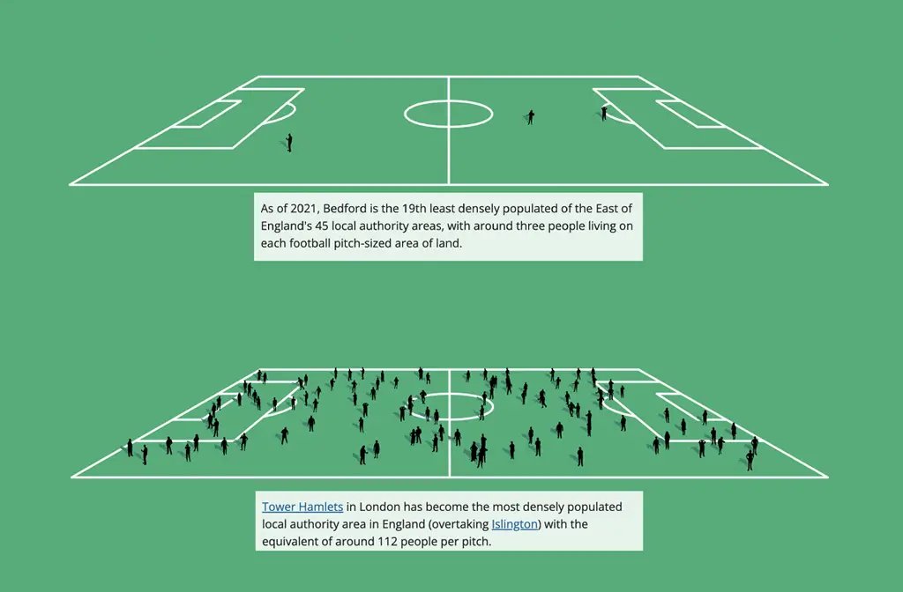
Using sentences to give context
As of 2021, Bedford is the 19th least densely populated of the East of England’s 45 local authority areas, with around three people living on each football pitch-sized area of land.
Tower Hamlets in London has become the most densely populated local authority area in England (overtaking Islington) with the equivalent of around 112 people per pitch.

Slide 54
Using sentences to give context: slide 2
At the other end of the population density scale for England, the amount of land in Eden in Cumbria works out at around five pitches per resident.

Slide 55
But do not mix things up!
If you want people to compare stick to one type
Example
100 people were asked - do you like cheeseburgers?
19% said yes, two thirds said no and 1 in 7 said don’t know.

Slide 56
What do you think?
If you want people to compare stick to one type
Example
100 people were asked - do you like cheeseburgers?
19% said yes, two thirds said no and 1 in 7 said do not know.
What did the majority of people say?
Source: made-up data

Slide 57
Getting people to do this . . .
If you want people to compare stick to one type
Example
100 people were asked - do you like cheeseburgers?
19% said yes, two thirds said no and 1 in 7 said don’t know.
19% 66.6 (recurring)% 14.3%

Slide 58
Finally, the answer!
If you want people to compare stick to one type
Example
100 people were asked - do you like cheeseburgers?
19% said yes, two thirds said no and 1 in 7 said don’t know.
19% 66.6 (recurring)% 14.3%

Slide 59
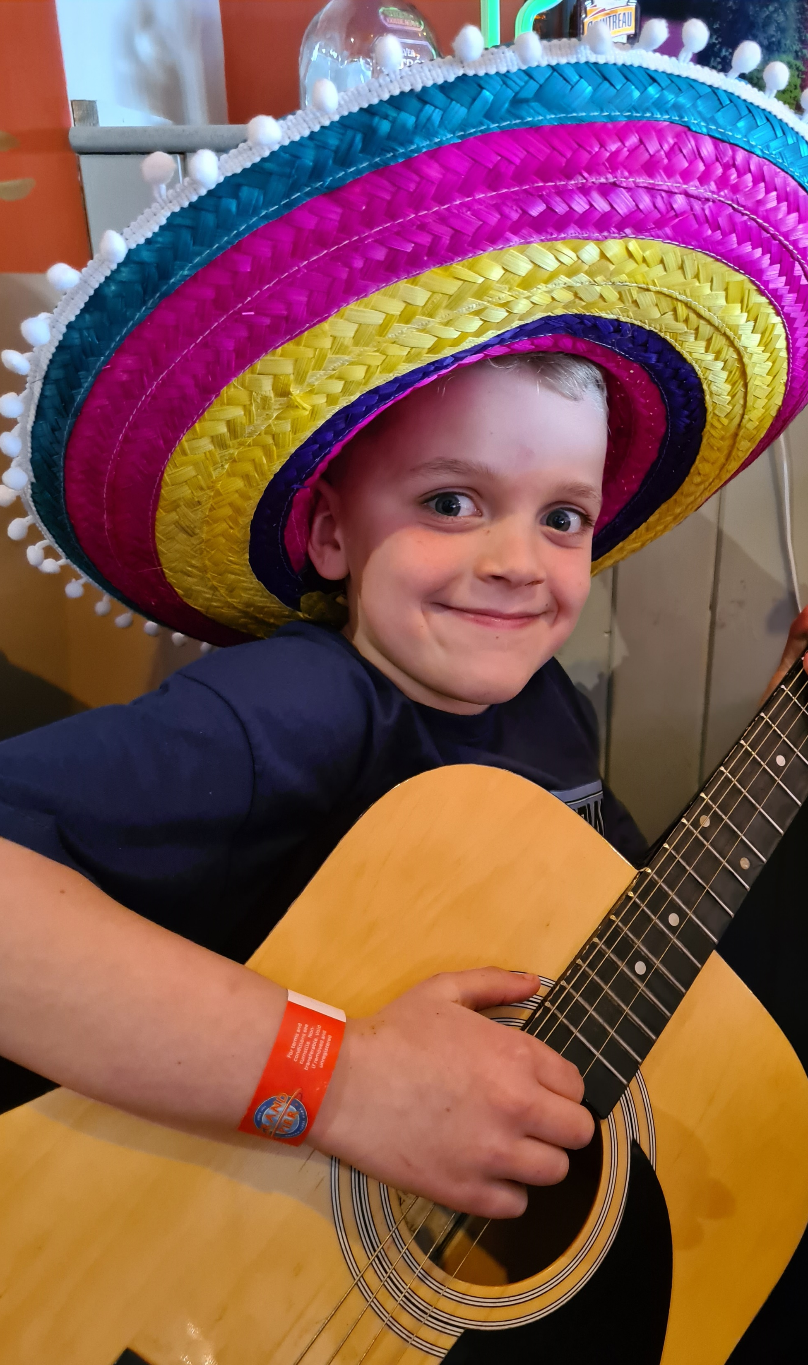
Use words with care
Do not do this:
A group of 8 year olds were asked their favourite colour:
1 in 10 picked pink, 2 in 5 chose blue and 1 in 20 picked red. The rest chose yellow.

Slide 60
Imagine you were asked this!
Do not do this:
A group of 8 year olds were asked their favourite colour
1 in 10 picked pink, 2 in 5 chose blue and 1 in 20 picked red. The rest chose yellow.
What was the least favoured colour?

Slide 61
Having to translate to this . . .
Do not do this:
A group of 8 year olds were asked their favourite colour
1 in 10 picked pink, 2 in 5 chose blue and 1 in 20 picked red. The rest chose yellow.
10% pink 40% blue 5% red 45% yellow

Slide 62
And use words with care
Do not do this:
A group of 8 year olds were asked their favourite colour
1 in 10 picked pink, 2 in 5 chose blue and 1 in 20 picked red. The rest chose yellow.
10% pink 40% blue 5% red 45% yellow

Slide 63
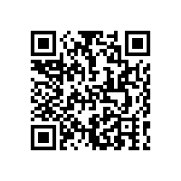
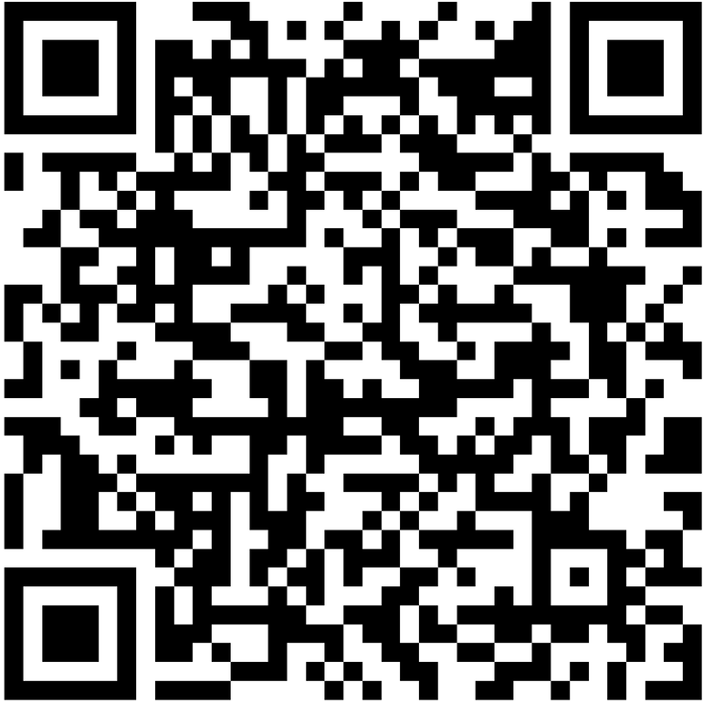
Thank you
https://www.smartsurvey.co.uk/s/AiGMonth23ThreePerspectives/
analysisfunction.civilservice.gov.uk/support/communicating-analysis/

