Slide 1
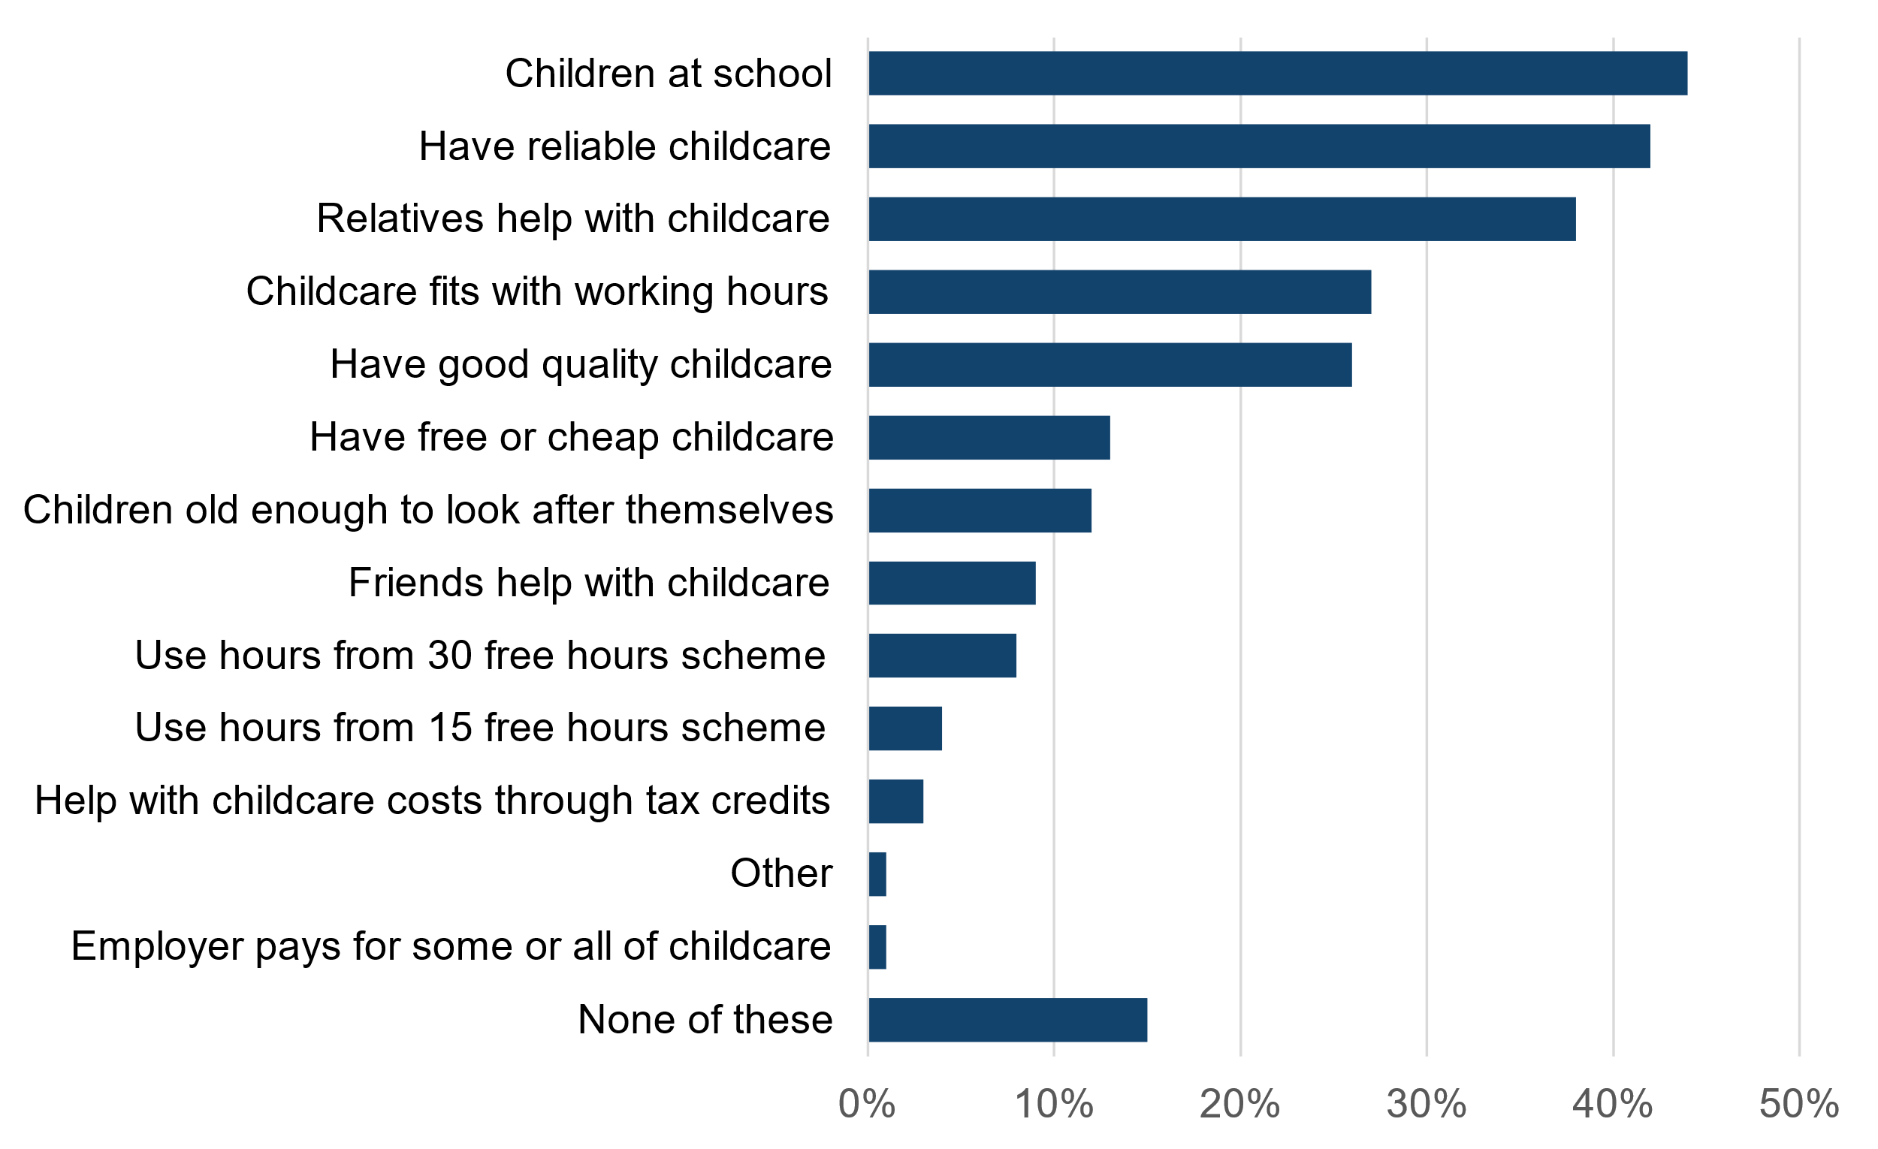
Solution for providing a text alternative
School most commonly stated childcare arrangement that helps mothers work
Headline title with main message
Figure 1: Percentage of mothers of children aged 0 to 14 in paid work who stated the listed childcare arrangement helped them go to work, England, 2021
Statistical subtitle starting with figure number
Image of chart in SVG format
Description of figure 1
The most commonly stated childcare arrangement that helped mothers go to work was children being at school (44% stated this).
Having reliable childcare or relatives to help were also popular (42% and 38% respectively).
Using hours from the 30 hours free childcare scheme was stated by 8%, while 4% stated using the 15 free hours scheme.
The least common arrangement was employer pays for some or all childcare (1%).
Text alternative for chart

Slide 2
Solution continued
In this example, it is reasonable to assume a non-disabled user would read off approximated data points from the chart.
This means providing an accessible table of the data in chart would also be a suitable text alternative.
The table also works well in this example because the list of arrangements is relatively small and there’s only one column of data which can be ranked.
This means users who cannot see or struggle to understand charts would not find it too difficult to understand the data by looking at the table or having it read out.
Childcare arrangements | Percentage stating the arrangement
Children at school | 44%
Have reliable childcare | 42%
Relatives help with childcare | 38%
Childcare fits with working hours | 27%
Have good quality childcare | 26%
Have free/cheap childcare | 13%
Children old enough to look after themselves | 12%
Friends help with childcare | 9%
Use hours from 30 free hours scheme | 8%
Use hours from 15 free hours scheme | 4%
Help with childcare costs through tax credits | 3%
Employer pays for some/all of childcare | 1%
Other | 1%
None of these | 15%

