Slide 1
Example: writing and incorporating text alternatives
The information on this slide is taken from a report on relative income poverty from Welsh Government.
This shows you the information you would have read out to you if you used screen reader software.
Task
Try to visualise what the chart looks like using the information given to you in this section. You might find using a pen and paper helpful.
Main findings
Between 2017-18 and 2019-20, 23% of all people in Wales were living in relative income poverty.
The percentage of people living in relative income poverty has been relatively stable in Wales for over 15 years.
In England the percentage of people living in relative income poverty was 22% between 2017 and 2020; in Scotland and Northern Ireland the figures were 19% and 18% respectively. (chart 1)
Alt text in alt attribute (the code behind the image):
Chart 1 shows the percentage of people in Wales, Scotland, England and Northern Ireland living in relative income poverty since the 3 year period 1997 to 2000.
Notes:
1

Slide 2
Visualising the information
This is what I came up with:
%
Main findings
Between 2017-18 and 2019-20, 23% of all people in Wales were living in relative income poverty.
The percentage of people living in relative income poverty has been relatively stable in Wales for over 15 years.
In England the percentage of people living in relative income poverty was 22% between 2017 and 2020; in Scotland and Northern Ireland the figures were 19% and 18% respectively. (chart 1)
Alt text in alt attribute (the code behind the image):
Chart 1 shows the percentage of people in Wales, Scotland, England and Northern Ireland living in relative income poverty since the 3 year period 1997 to 2000.
23
Wales
England
Scotland
Northern Ireland
15
1997
to
2000
2017-18
to
2019-20
Notes:
2

Slide 3
Same example with more information
People in relative income poverty
23% of people in Wales in relative income poverty
Figure 1: Percentage of people in each UK country living in relative income poverty (after housing costs), averages of three-financial-years, 1997 to 2020, FYE = Financial Year Ending
On this slide we have rearranged and added to the information given to the user.
We have:
made the section title descriptive
given the chart a headline title and a statistical title
combined the main bullet points into the text alternative which is now in the body text rather than in the alt attribute
Task
Try to visualise the chart again using this information. As before you might find using a pen a paper helpful.
[Image of chart would sit here]
Description of figure 1
During the latest period we have data for (FYE 2018 to FYE 2020), 23% of all people in Wales were living in relative income poverty (after accounting for housing costs).
In England in the same period, the percentage was 22% - in Scotland and Northern Ireland the figures were 19% and 18% respectively
Percentages for all countries have been relatively stable for over 15 years, although Northern Ireland appears to be on a recent downward trend.
In the early part of the period (FYE 98 to FYE 00) percentages for all countries were nearer to 25%.
Notes:
3

Slide 4
Visualising the information again
People in relative income poverty
23% of people in Wales in relative income poverty
Figure 1: Percentage of people in each UK country living in relative income poverty (after housing costs), averages of three-financial-years, 1997 to 2020, FYE = Financial Year Ending
This is what I came up with this time from the given information:
%
[Image of chart sits here]
25
23
Wales
England
Scotland
Northern Ireland
15
Description of figure 1
During the latest period we have data for (FYE 2018 to FYE 2020), 23% of all people in Wales were living in relative income poverty (after accounting for housing costs).
In England in the same period, the percentage was 22% - in Scotland and Northern Ireland the figures were 19% and 18% respectively
Percentages for all countries have been relatively stable for over 15 years, although Northern Ireland appears to be on a recent downward trend.
In the early part of the period (FYE 98 to FYE 00) percentages for all countries were nearer to 25%.
1998
to
2000
2018
to
2020
Averages of three financial years
Notes:
4

Slide 5
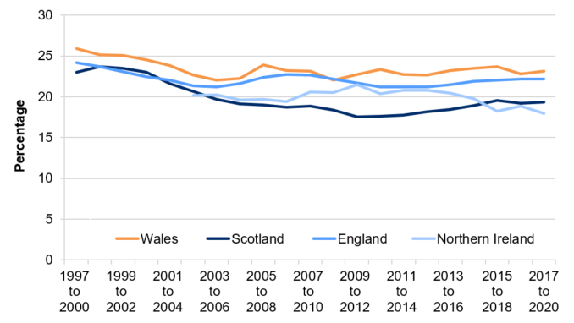
Comparing my chart
People in relative income poverty
23% of people in Wales in relative income poverty
Figure 1: Percentage of people in each UK country living in relative income poverty (after housing costs), averages of three-financial-years, 1997 to 2020, FYE = Financial Year Ending
My chart is now closer to the chart in the report.
%
25
23
Wales
England
Scotland
Northern Ireland
15
Description of figure 1
During the latest period we have data for (FYE 2018 to FYE 2020), 23% of all people in Wales were living in relative income poverty (after accounting for housing costs).
In England in the same period, the percentage was 22% - in Scotland and Northern Ireland the figures were 19% and 18% respectively
Percentages for all countries have been relatively stable for over 15 years, although Northern Ireland appears to be on a recent downward trend.
In the early part of the period (FYE 98 to FYE 00) percentages for all countries were nearer to 25%.
1998
to
2000
2018
to
2020
Averages of three financial years
Notes:
5

Slide 6
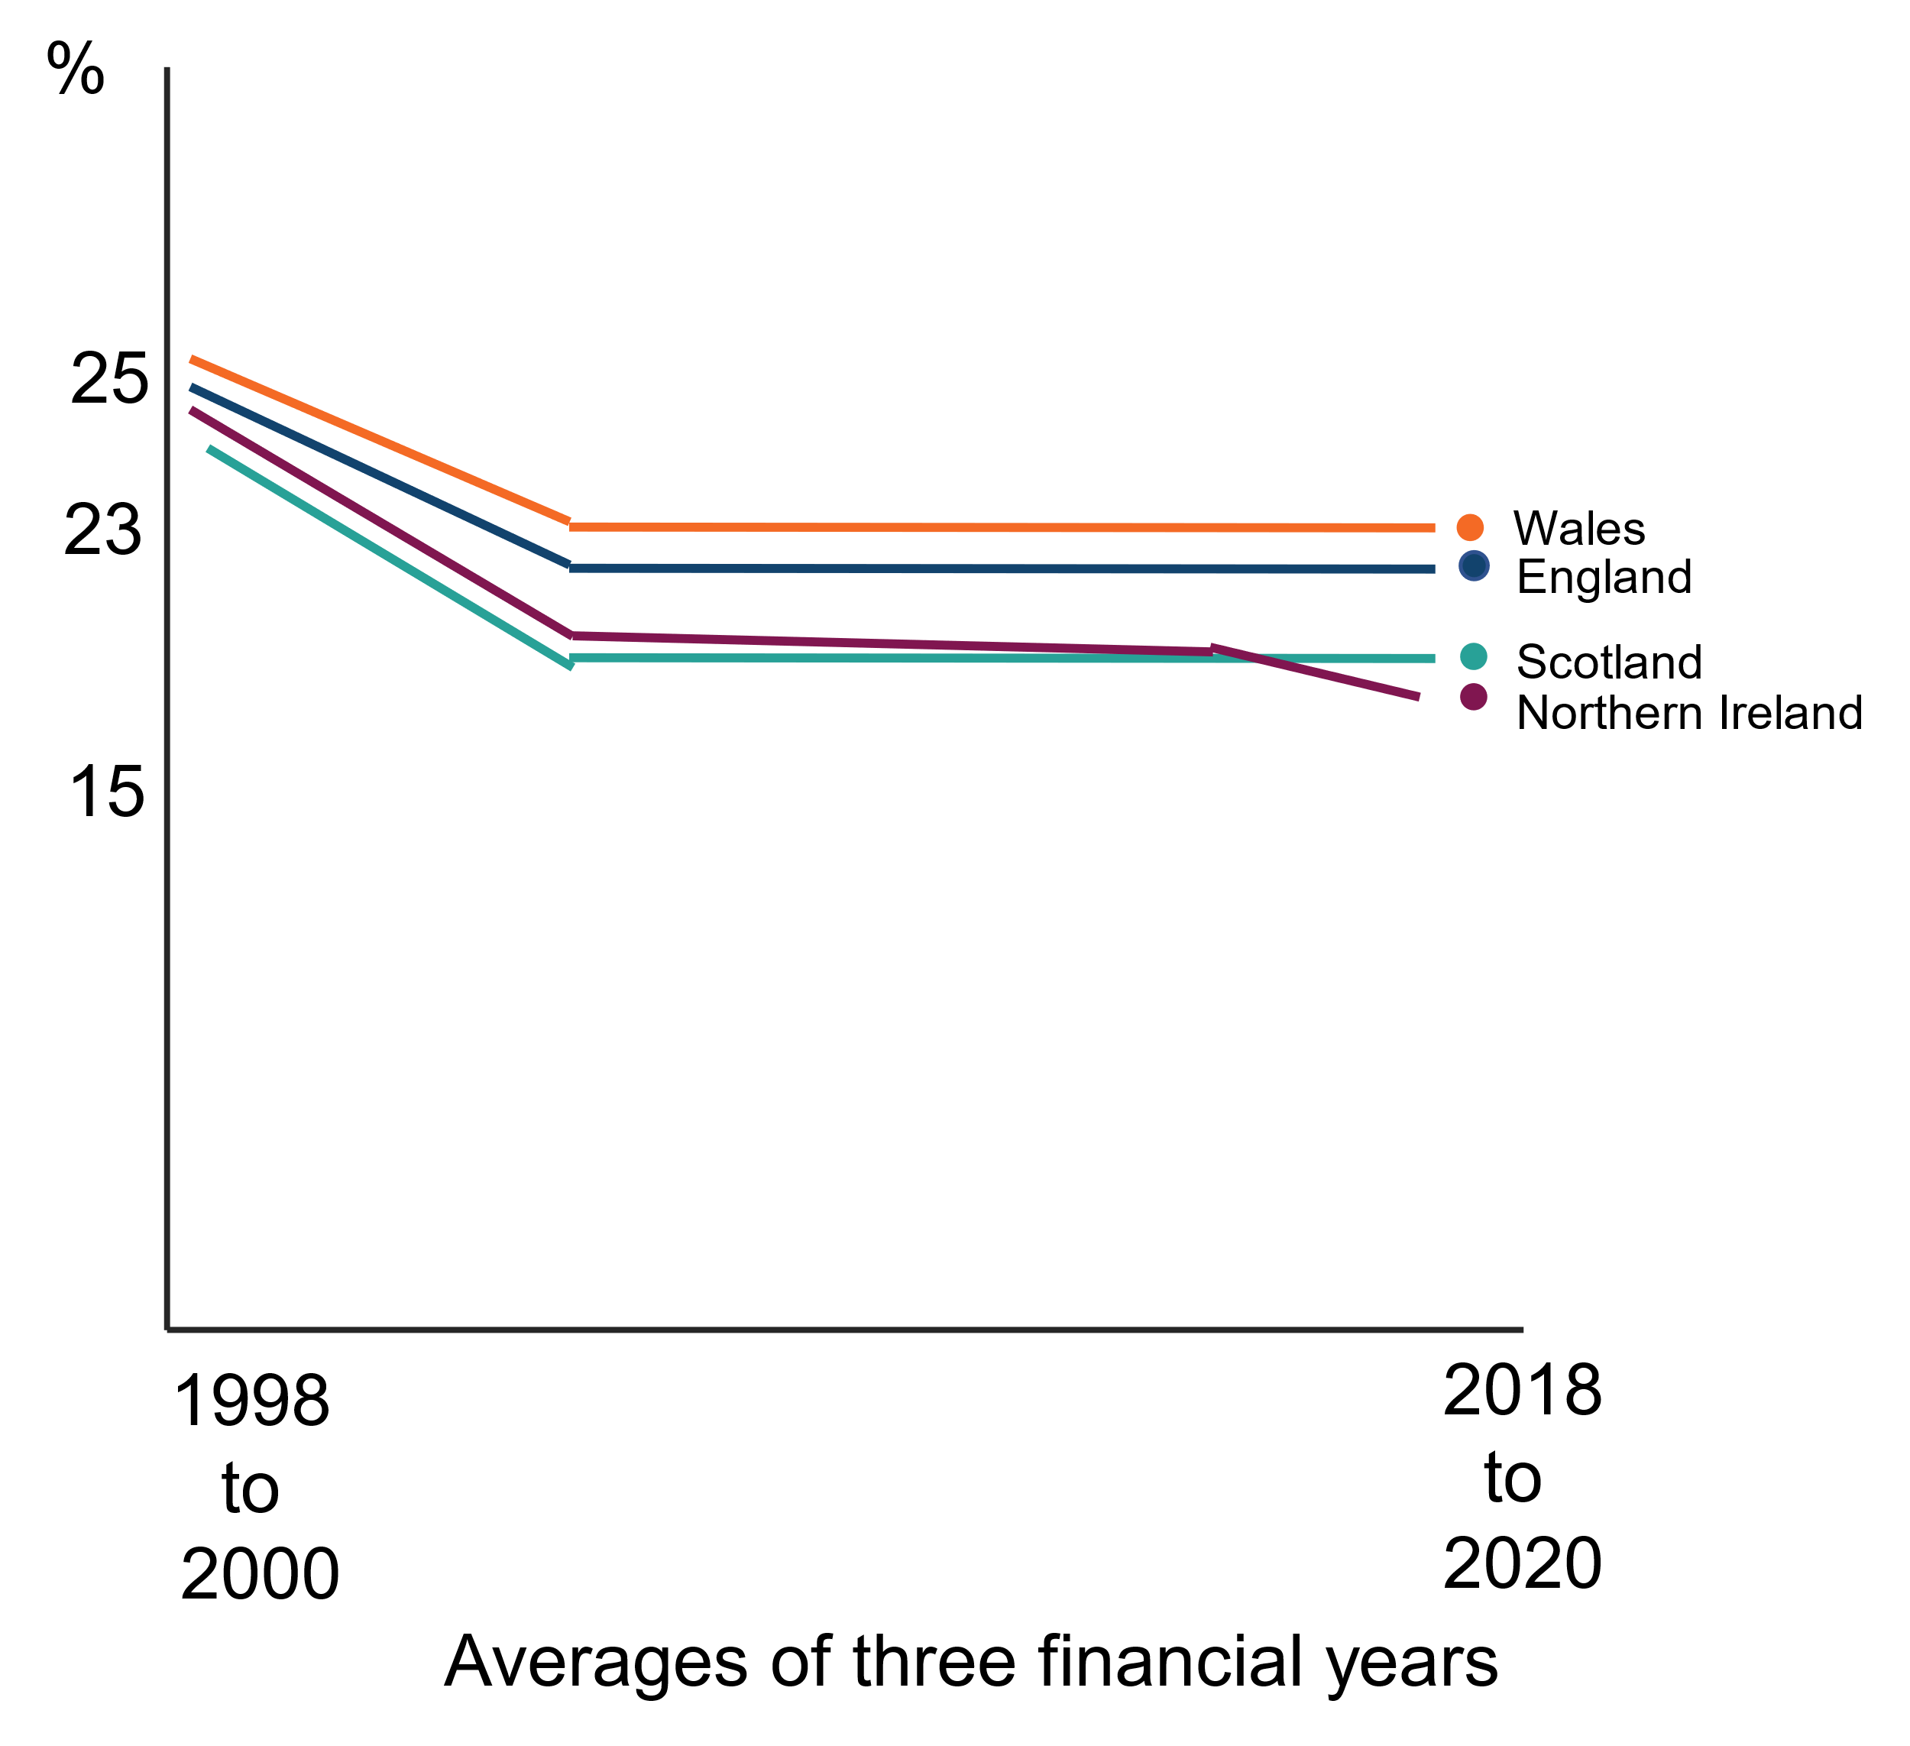
Conclusion
This example shows that when we consider how to combine the text alternative with the surrounding information we can help all users better understand our content.
We can particularly help users who have trouble seeing or reading information from charts.
Notes:
6

Slide 7
Exercise
Percentage of mothers with children aged 0 to 14 in paid work who stated the listed childcare arrangement helped them go to work, England, 2021
Task
Draw a chart of this data and decide what the best text alternative would be.
You can choose a text description, a table, or both.
If you decide to go for a text description, imagine you are describing the chart to someone over the phone – what would you say?
Childcare arrangements | Percentage selecting the option
Children at school | 44%
Have reliable childcare | 42%
Relatives help with childcare | 38%
Childcare fits with working hours | 27%
Have good quality childcare | 26%
Have free/cheap childcare | 13%
Children old enough to look after themselves | 12%
Friends help with childcare | 9%
We use free hours of childcare for 3 and 4 year olds (under the 30 free hours scheme) | 8%
We use free hours of childcare for 3 and 4 year olds (under the 15 free hours scheme) | 4%
Help with childcare costs through tax credits | 3%
Employer pays for some/all of childcare | 1%
Other | 1%
None of these | 15%
Source: Department for Education - Childcare and early years survey of parents

